Slide 1

Walmart Store Data Visualization for Analysis
By: David Powers

Slide 2
Problem: How Can a big retailer like Walmart visualize what stores are failing and why
Recent News of Walmart Closings Causing Chaos in Major Metropolitan Areas
Walmart Stores have been struggling to turn a profit and have closed multiple locations
Walmart had a Net Profit Margin of Just 2.36% as of July 31, 2022
How does the Consumer Price Index, Individual Store, and the Time of Year affect the weekly sales of Walmart locations.

Slide 3
Data Sources
The data was aquired on Kaggle.com and was already compressed into a .csv file
Read and plotted by CPI, Date, and Store Number in .py
The most conclusive results for specific time frame, area, and economic factors.

Slide 4
Solution
Create a program in python that could take the massive amount of data points and condense them into graphs.
These graphs break down the weekly sales dependent on each of the aforementioned factors.
This would allow for Walmart management to have a clear view of how economic, seasonal, and regional factors effect sales.

Slide 5
Solution Modules, Functions, and Python Libraries Employed
Packages Used:
Pandas
matplotlib
Functions Employed:
process_data(df)
read_data(file_path)
plot_sales_by_store(df)
plot_sales_by_cpi
plot_sales_by_date

Slide 6
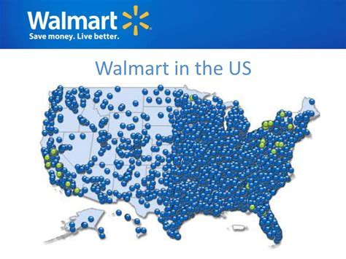
Results

Slide 7
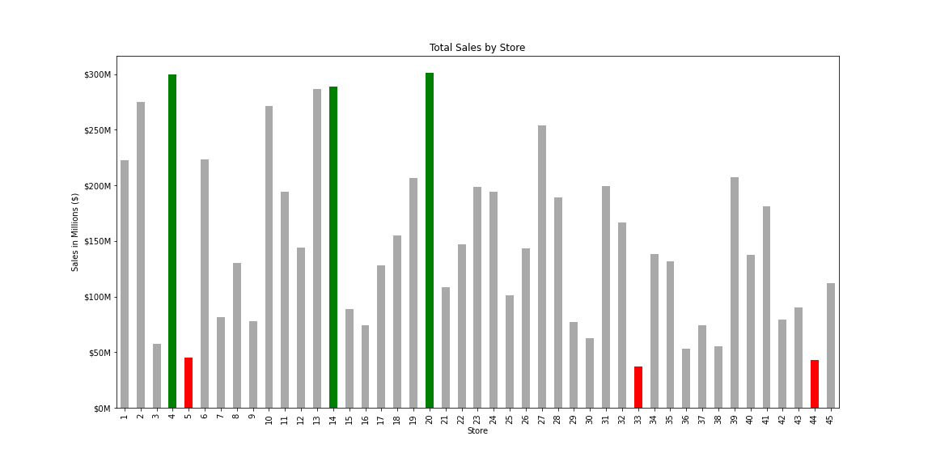

Slide 8
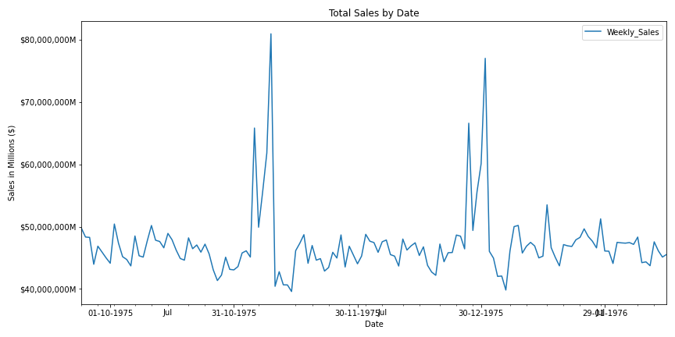

Slide 9
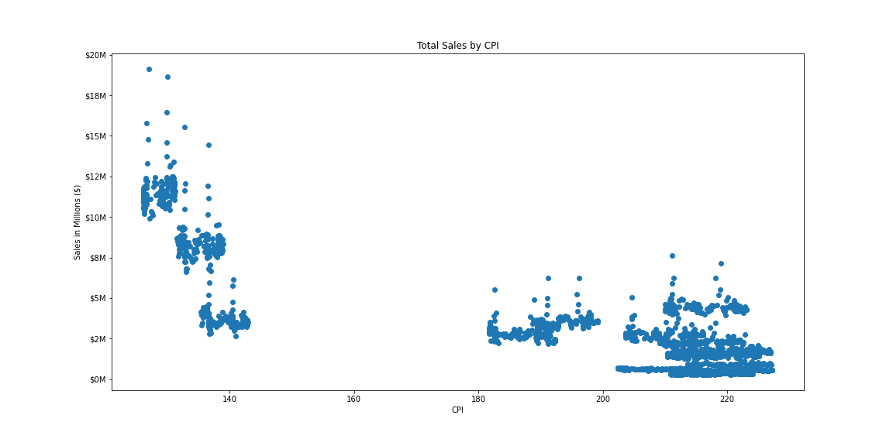

Slide 10

Takeaways and Conclusions for:

